Slide 1
Cousera Capstone Project
By: Thang Nguyen

Slide 2
Context
Introduction
Data
Methodology
Results and discussion
Conclusion

Slide 3
Introduction
Finding the “perfect” apartment has always been a pain in the neck for some people since there are so many places that are available, but so few good choices available
Don’t worry, we have the solution for you.

Slide 4
Data
Wikipedia helps usby providing Postal Code, Borough and Neighbourhood in Toronto
Geospatial data for Toronto contains the geographical coordinates of each postal code
Foursquare API allows to obtain the data on what venues are located at each neighbourhood
Random user data, with a random number (from 1 to 10) of preferences to check, how our system works

Slide 5
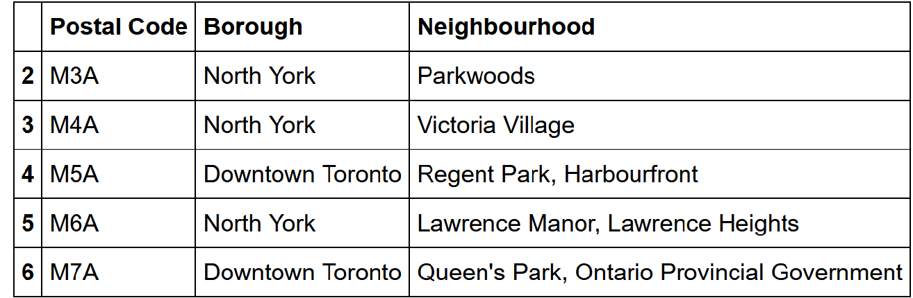
Methodology
Pandas library is used to scrape the data

Slide 6
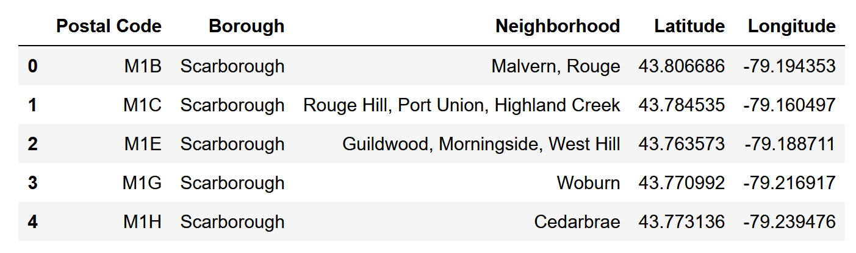
Methodology
Geospatial data for Toronto contains the geographical coordinates of each postal code

Slide 7
Methodology
Foursquare API allows to obtain the data on the surrounding of the place and what venues are located at each neighbourhood
apply OneHot encode to get a new table with the neighbourhood as the index and percentage of each category available in that neighbourhood

Slide 8
Methodology
Random User – Generate a random User to use for a test of the system
Select a random number from 1 to 10 to represent the amount of categories selected by the user
Create a table with the categories as the columns and one row, where the values are 1 if the user has that category in his list and 0 for vice versa

Slide 9
Methodology
Recommendation system
Multiply the user profile with the table that has the neighbourhood and the weight of each category
Result is a matrix with the score of each neighbourhood
The higher score, the better the neighbourhood fit the user interest

Slide 10
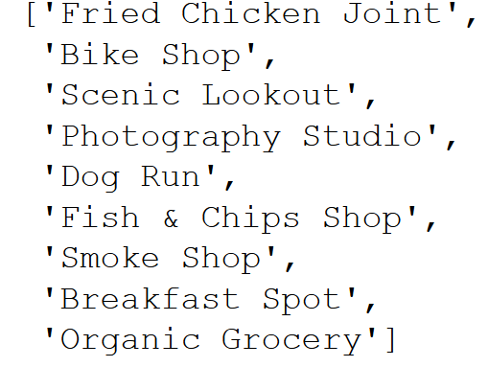
Results and discussion
This is the user’s category generated by filling it with random traits

Slide 11
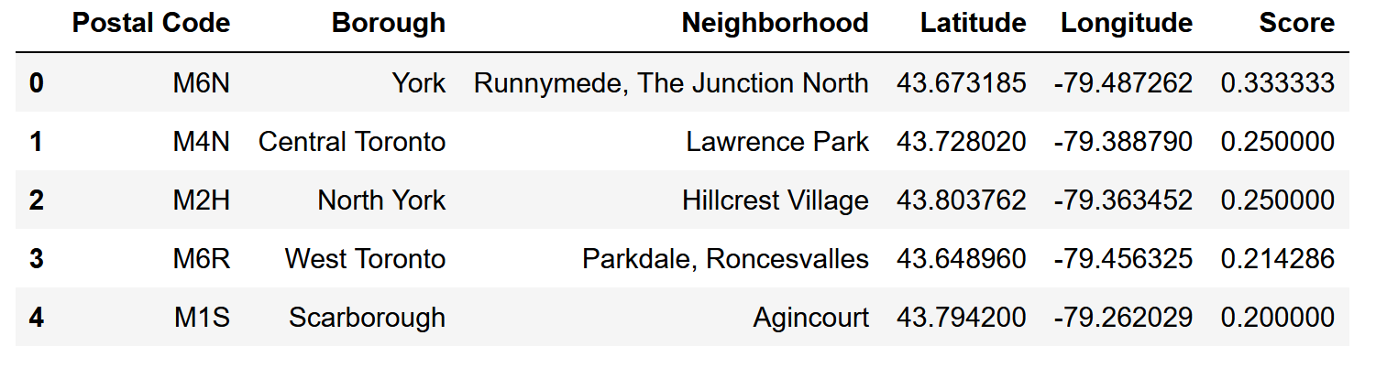
Result and discussion

Slide 12
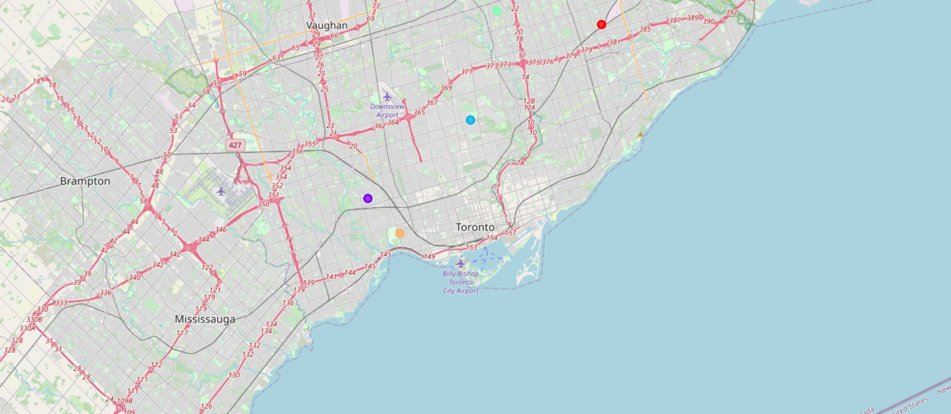
Result and discussion

Slide 13
Result and discussion
From the table above, there are two good neighborhoods for our user are “Runnymede, The Junction North” and “Lawrence Park”.
From the table, we can observe that the difference between the scores of each place is not significant and the reason behind that, maybe, because the user’s preference is common, and do not contain any outlier such as “Airport food court”

Slide 14
Conclusion
This is a sample of a content-based recommender system but still need more development. We need more data in order to improve our accuracy, and also make it available with rural places. A lot of work still need to be done to improve this.

